Slide 1

Lifestyle Store Web Application
Detailed Developer Report

Slide 2
Security Status – Extremely Vulnerable
Hacker can steal all records in Internshala databases (SQLi)
Hacker can take control of complete server including View, Add, Edit, Delete files and folders (Shell Upload)
Hacker can change source code of application to host malware, phishing pages or even explicit content (Shell Upload)
Hacker can inject client side code into applications and trick users by changing how page looks to steal information or spoil the name of Internshala (XSS)
Hacker can extract mobile number of all customers using Userid (IDOR)

Slide 3
Vulnerability Statistics
Critical
12
Severe
7
Moderate
3
Low
3

Slide 4
Vulnerabilities:
No | Severity | Vulnerability | Count
1 | Critical | SQL Injection | 2
2 | Severe | Stored And Reflected XSS | 3
3 | Critical | IDOR | 4
4 | Severe | Rate Limiting Flaws | 2
5 | Critical | Insecure File Upload | 2
6 | Moderate | Client Side Filter Bypass | 2
7 | Severe | Server Misconfiguration | 2
8 | Critical | PII Leakage | 4
9 | Critical | Open Redirection | 4
10 | Severe | CSRF | 3

Slide 5
1. SQL Injection
SQL Injection (Critical) | Below mentioned URL is vulnerable to SQL injection attack Affected URL : http://3.6.90.39/products.php?cat=1 Affected Parameters : Category(GET parameter) Payload: cat=1’

Slide 6
1. SQL Injection
SQL Injection (Critical) | Here are other similar SQLi in the application Affected URL : http://3.6.90.39/products.php?cat=2 (GET Parameter) http://3.6.90.39/products.php?cat=3 (GET Parameter

Slide 7
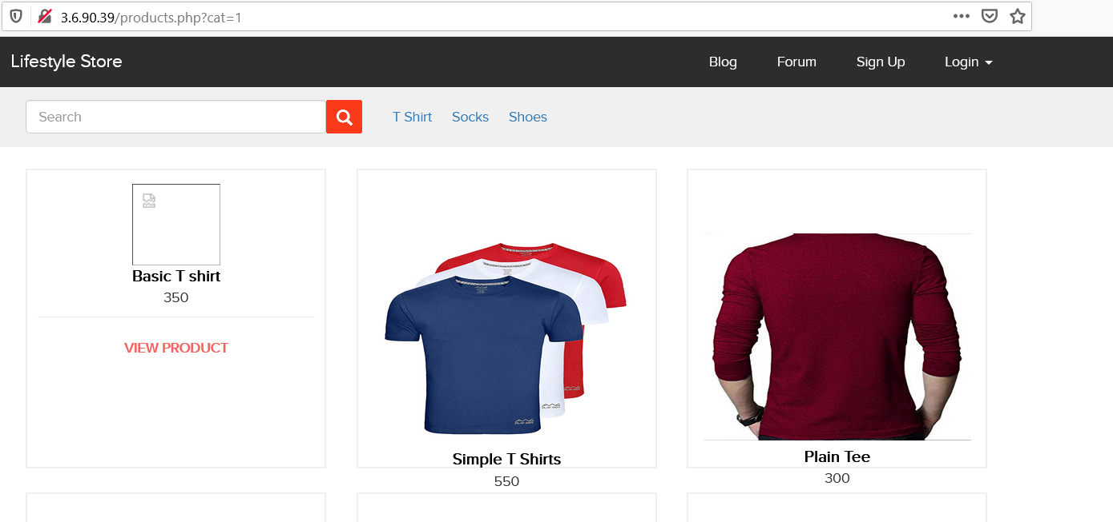
Observation
Navigate to the main page of the website where you will see categories option . Click on “T-Shirt” or “Socks” or “Shoes” to get into this URL , You will see products as per the option you have chosen. Notice the GET parameter cat in the URL:

Slide 8
Observation
We apply single quote in GET parameter: products.php?cat=1’ and we get complete MySQL error:

Slide 9
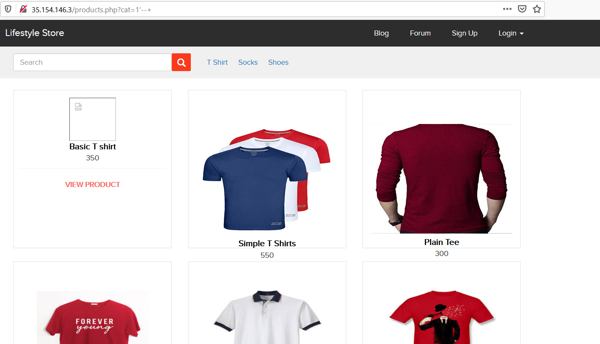
Observation
We then put --+ in the end of the parameter : products.php?cat=1’--+ we’ll get the page back to its original form, error is removed confirming SQL injection:

Slide 10
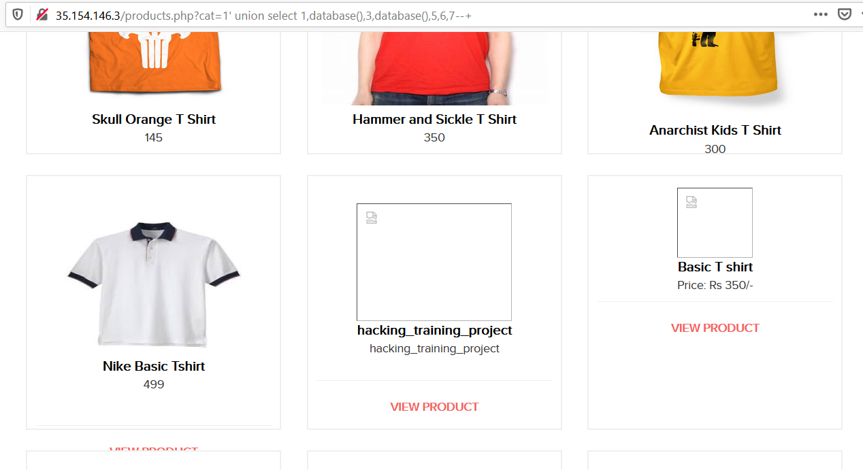
Proof of Concept (PoC)
Attacker can execute SQL commands as shown below. Here we have used the payload below to extract the database name and MySQL version information: cat=1’ union select 1,database(),3,database(),5,6,7--+

Slide 11
PoC – Attacker can dump arbitrary data
No of databases: 2
Information_schema
hacking_training_project
No of tables in hacking_training_project: 10
brands
cart_items
categories
customers
order_items
orders
product_reviews
products
sellers
users

Slide 12
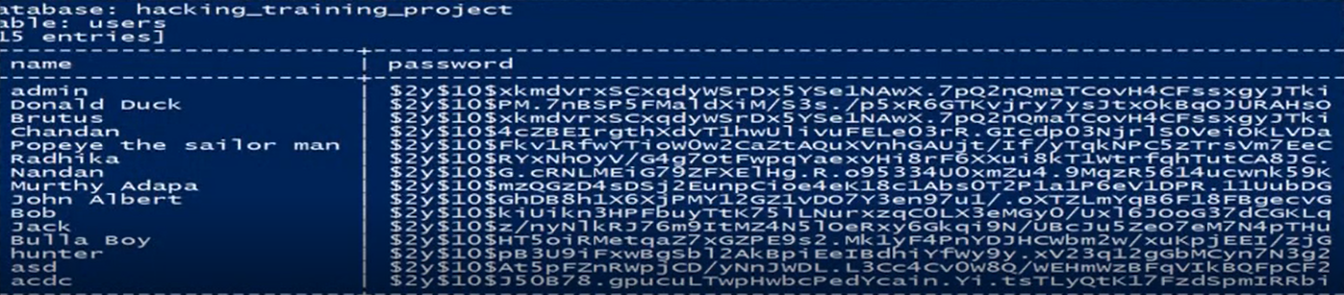
Business Impact – Extremely High
Using this vulnerability, attacker can execute arbitrary SQL commands on Lifestyle store server and gain complete access to internal databases along with all customer data inside it.
Below is the screenshot of users table which shows user credentials being leaked , Although they are in encrypted form but decryption is quite easy for hackers.
Attacker can use this information to login to admin panels and gain complete admin level access to the website which could lead to complete compromise of the server and all other servers connected to it.

Slide 13
Recommendation
Take the following precautions to avoid exploitation of SQL injections:
Prepared Statements: Use SQL prepared statements available in all web development languages and frameworks to avoid attacker being able to modify SQL query
Character encoding: If you are taking input that requires you to accept special characters, encode it. Example. Convert all ‘ to \’ , “ to \”, \ to \\. It is also suggested to follow a standard encoding for all special characters such has HTML encoding, URL encoding etc
Do not run Database Service as admin/root user
Disable/remove default accounts, passwords and databases
Assign each Database user only the required permissions and not all permissions

Slide 14
References
https://www.owasp.org/index.php/sql_injection
https://en.wikipedia.org/wiki/sql_injection

Slide 15
2. Account Takeover via OTP Bypass
Account takeover using OTP (Critical) | Below mentioned login page allows login via OTP which can be brute-forced. Affected URL : http://35.154.146.3/login/admin.php Affected Parameters : OTP (POST parameters)

Slide 16
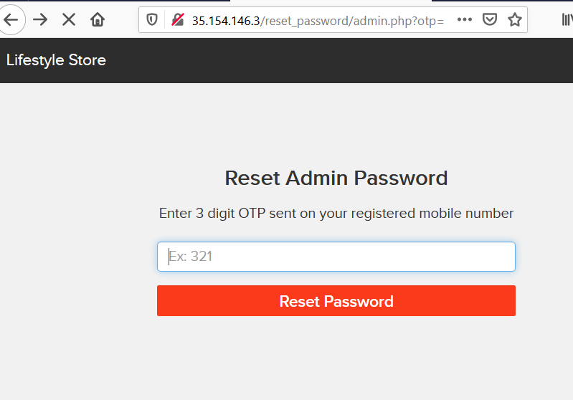
Observation
Navigate to http://35.154.146.3/login/admin.php You will see a “forgot password” hyperlink which asks for OTP which is sent to victim’s mobile number, write any random 3 digit OTP and intercept the request with Burp Suite.

Slide 17
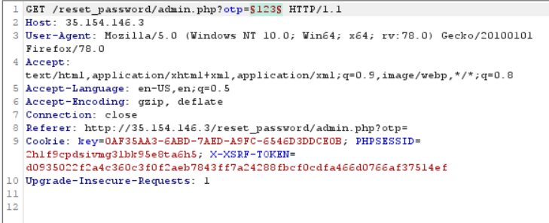
Observation
Following request will be generated in Burp using OTP parameter(GET).

Slide 18
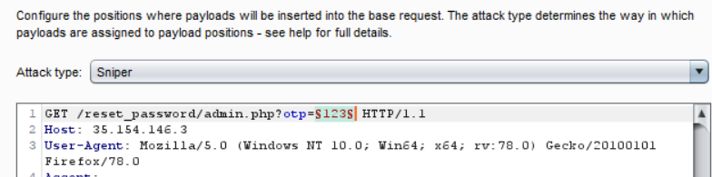
Observation
Using Burp Suite we’ll brute force by getting all combinations of 3 digit OTP’s and enter the correct one to bypass.

Slide 19
Business Impact – Extremely High
A malicious user can gain complete access to admin account just by Brute-forcing due to Rate Limiting Flaw as a hacker can attempt as many times as he wants as there is no bounds for number of requests or number of tries. So, this leads to complete compromise of personal user data of every customer . Attacker once logs in can then carry out actions on behalf of the victim which could lead to serious financial loss to the victim.

Slide 20
Recommendation
Take the following precautions:
Use proper rate-limiting checks on the no of OTP checking and Generation requests
Implement anti-bot measures such as ReCAPTCHA after multiple incorrect attempts
OTP should expire after certain amount of time like 2 minutes
OTP should be at least 6 digit and alphanumeric for more security
References:
https://www.owasp.org/index.php/Testing_Multiple_Factors_Authentication_(OWASP-AT-009)
https://www.owasp.org/index.php/Blocking_Brute_Force_Attacks

Slide 21
3. Unauthorized Access to Customer Details
Unauthorised Access to Customer Details (Critical) | The My orders section of the website suffers from an Insecure Direct Object Reference(IDOR),that allows hackers to get access to any other customers order details and more. Affected URL : http://15.206.73.33/orders/orders.php?customer=2 Affected Parameters : customer (GET)

Slide 22
4. Unauthorised Access to Customer Details
Unauthorized Access to Customer Details (Critical) | Similar issue is found on below modules too Affected URL : http://15.206.73.33/products/details.php?p_id=7 Affected parameters : p_id (GET)

Slide 23
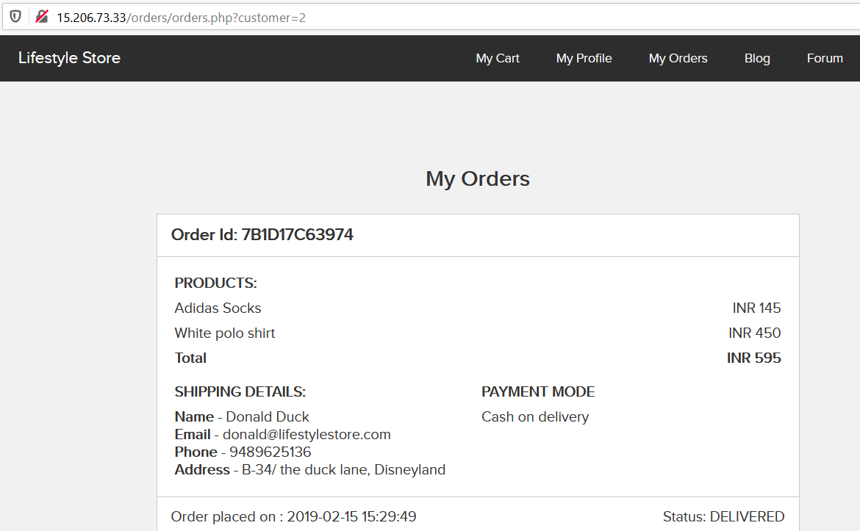
Observation
Login to your account and go to “My Orders” section, you’ll see a get parameter as shown below,”Customer=2”

Slide 24
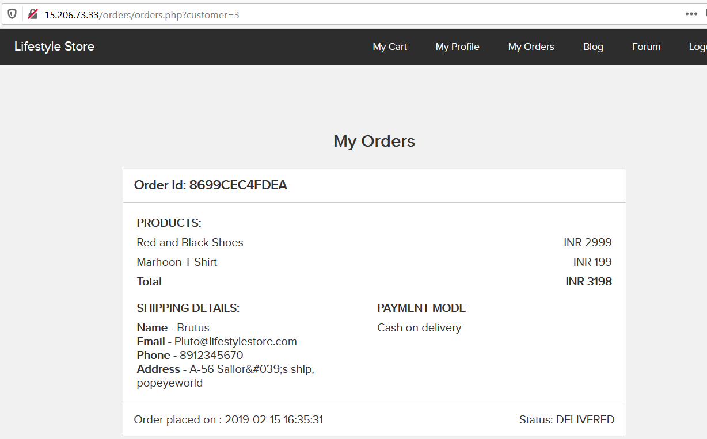
Observation
Change the customer number to any other random number in our case ,I am going to write 3 and you’ll see order details of other customer.

Slide 25
Business Impact – Extremely High
A malicious hacker can read bill information of any user just by knowing the User ID. This discloses critical billing information of users including:
Name
Email
Phone no.
Address
Order ID
Bill amount
This can be used by malicious hackers to carry out targeted phishing attacks on the users and the information can also be sold to competitors/blackmarket.
More over, as there is no ratelimiting checks, attacker can bruteforce the user_id for all possible values and get bill information of each and every user of the organization resulting is a massive information leakage(PII leakage).

Slide 26
Recommendation
Take the following precautions:
Implement proper authentication and authorisation checks to make sure that the user has permission to the data he/she is requesting
Use proper rate limiting checks on the number of request comes from a single user in a small amount of time
Make sure each user can only see his/her data only.
References:
https://www.owasp.org/index.php/Insecure_Configuration_Management
https://www.owasp.org/index.php/Top_10_2013-A4-Insecure_Direct_Object_References

Slide 27
5. Reflected Cross Site Scripting (XSS)
Reflected Cross Site Scripting (Severe) | Below mentioned parameters are vulnerable to reflected XSS Affected URL : http://15.206.73.33/products/details.php?p_id=2 Affected Parameters : URL(anything after p_id) Payload: <script>alert(1)</script>

Slide 28
5. Reflected Cross Site Scripting (XSS)
Reflected Cross Site Scripting (Severe) | Below mentioned parameters are vulnerable to reflected XSS Affected URL : http://15.206.73.33/products/details.php?p_id=2 Affected Parameters : Comment(review box) Payload: In review comment <script>alert(1)</script>

Slide 29
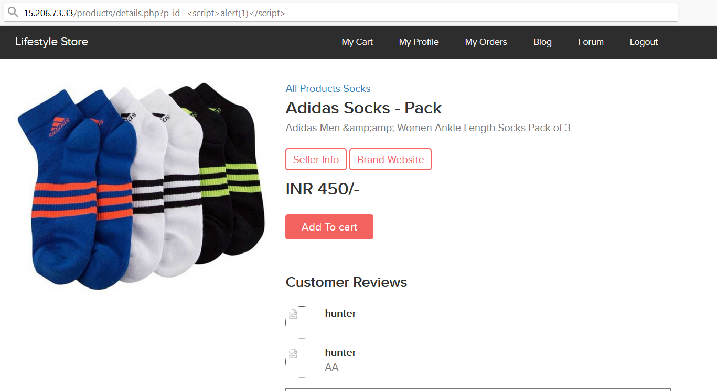
Observation
Navigate to the site and log in to your account go to products and select any product. Now url shows the ID of the product you are on , replace that with the shown payload.

Slide 30
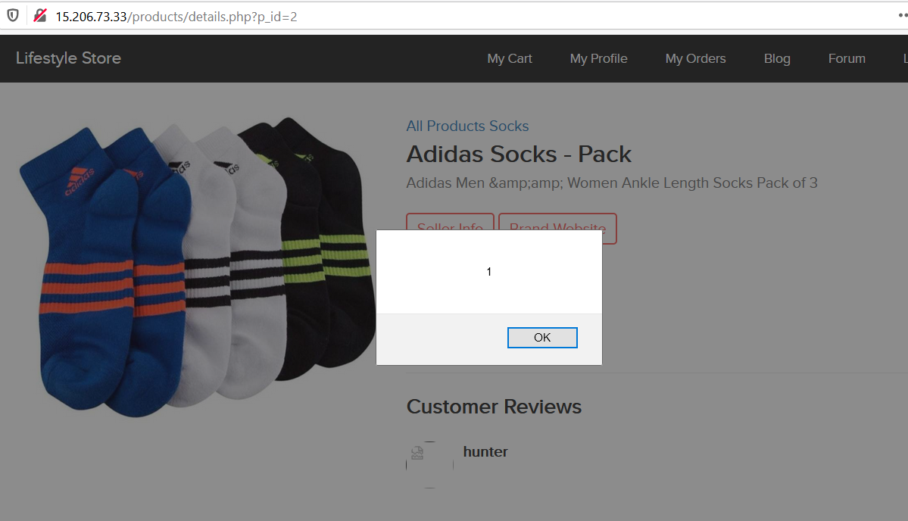
Observation
After entering the payload press enter , the page will redirect you to home page but when you click on the same product again it will show the shown result(alert box).

Slide 31
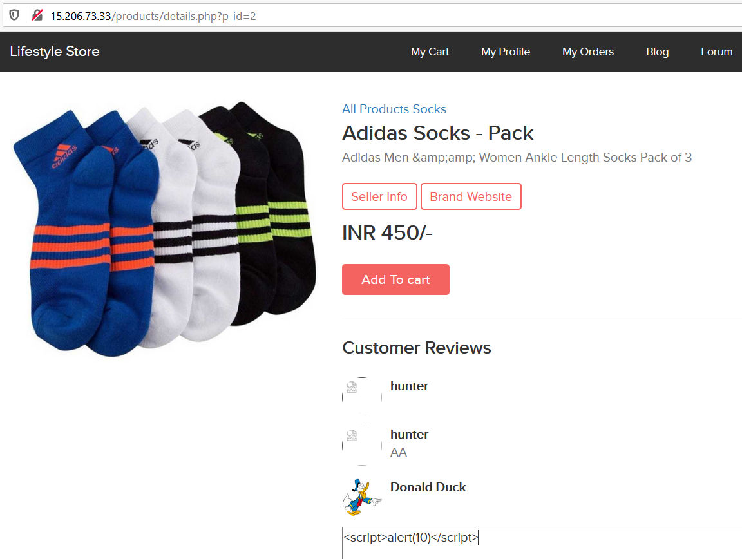
PoC
XSS can be done in review/comment section also.

Slide 32
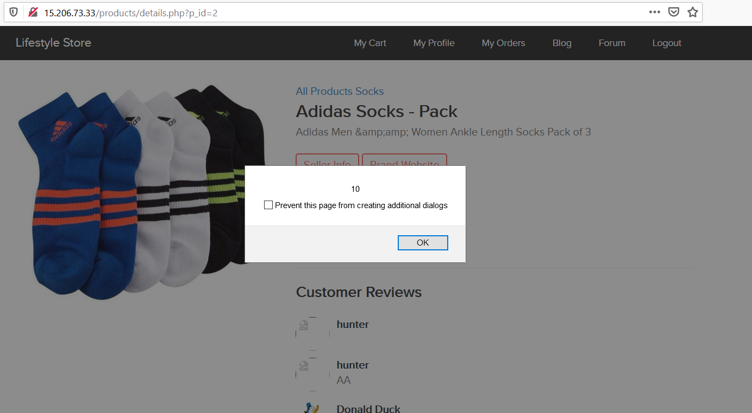
PoC

Slide 33
Business Impact – High
As attacker can inject arbitrary HTML CSS and JS via the URL, attacker can put any content on the page like phishing pages, install malware on victim’s device and even host explicit content that could compromise the reputation of the organization
All attacker needs to do is send the link with the payload to the victim and victim would see hacker controlled content on the website. As the user trusts the website, he/she will trust the content.

Slide 34
Recommendation
Take the following precautions:
Sanitize all user input and block characters you do not want.
Convert special HTML characters like ‘ “ < > into HTML entities &quot; %22 &lt; &gt; before printing them on the website
References:
https://www.owasp.org/index.php/Cross-site_Scripting_(XSS)
https://en.wikipedia.org/wiki/Cross-site_scripting
https://www.w3schools.com/html/html_entities.asp

Slide 35
6. Directory Listing
Directory Listing (Moderate) | Below mentioned parameters are vulnerable to reflected XSS Affected URL : http://15.206.73.33/robots.txt

Slide 36
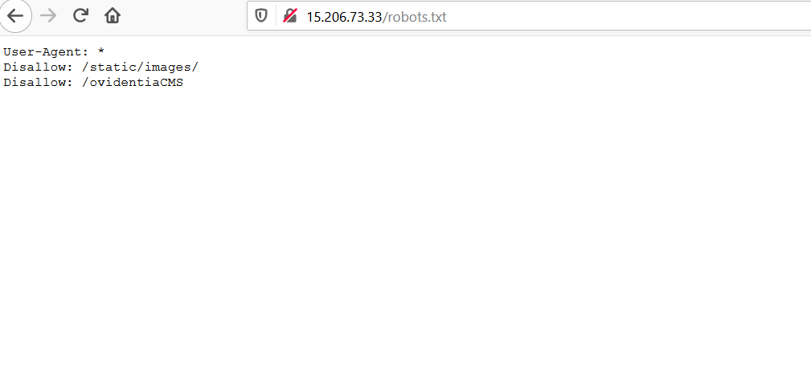
Observation
Navigate to http://15.206.73.33/robots.txt
Complete listing of directories of the customer and images of products and all the products page info and the administrator directory is also shown.
Also this suffers with weak password flaw in ovidentiaCMS, which lets an attacker get inside the administrator panel without much trying.

Slide 37
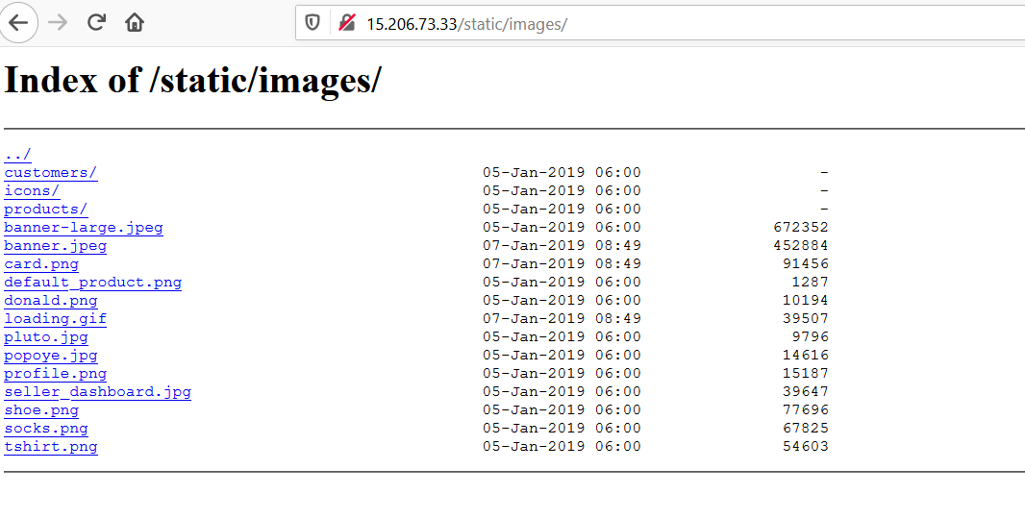
POC

Slide 38
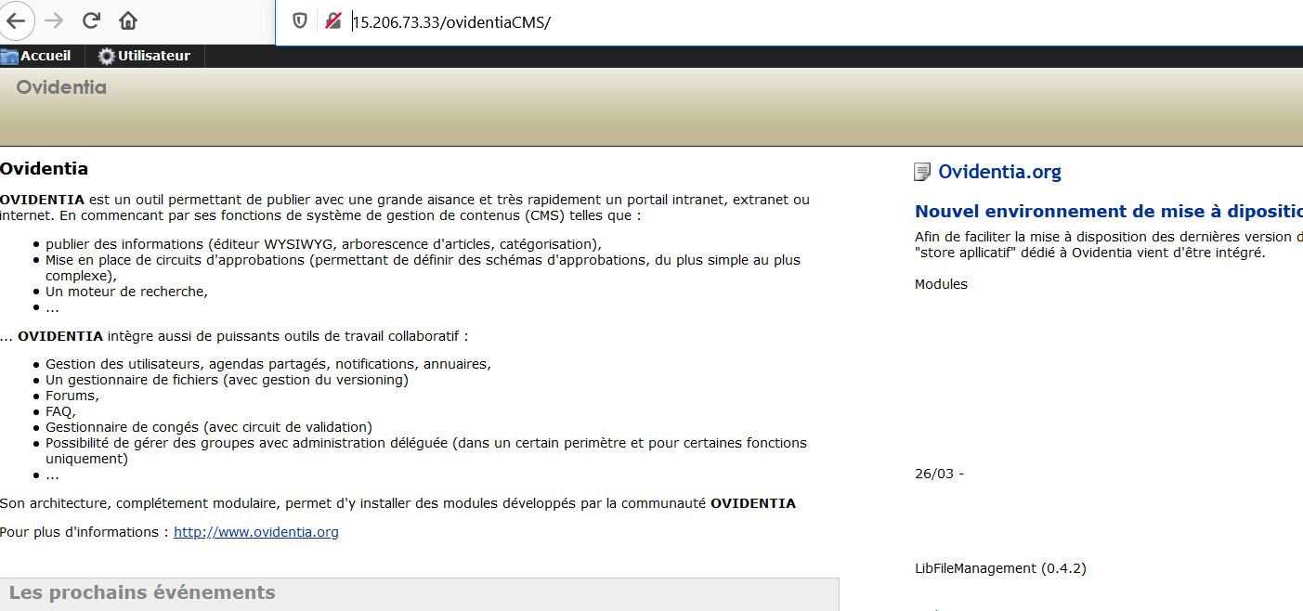
POC

Slide 39
Business Impact – High
Although this vulnerability does not have a direct impact to users or the server, though it can aid the attacker with information about the server and the users.
A hacker can get all the information on the CMS and also fiddle with the administrator logins and compromise the whole name of the company.
A malicious hacker can take important information from seller point of view and products every seller is selling at what price and also the information of uses.

Slide 40
Recommendation
Take the following precautions:
Disable Directory Listing
Put an index.html in all folders with default message
Remove all the default passwords and add your own new strong passwords which must have a special character and a number and must be greater or equal to 8 digits for maxim
References:
https://cwe.mitre.org/data/definitions/548.html
https://www.netsparker.com/blog/web-security/disable-directory-listing-web-servers/

Slide 41
7. Information Disclosure
Information Disclosure due to Apache Info Page (Low) | Below mentioned urls disclose server information Affected URL : http://15.206.73.33/server-status/

Slide 42
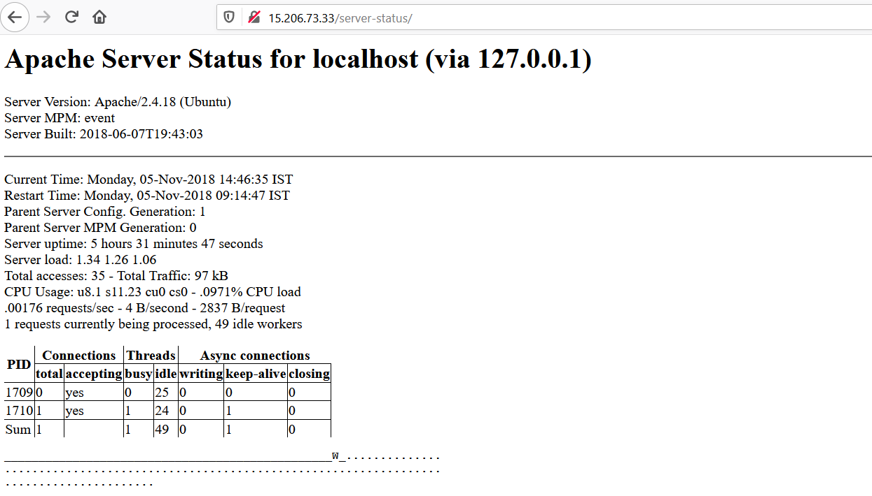
Observation
Navigate to http://15.206.73.33/server-status/
Default server-status page opens which discloses server information

Slide 43
Business Impact – Moderate
Although this vulnerability does not have a direct impact to users or the server, though it can help the attacker in mapping the server architecture and plan further attacks on the server
Recommendation
Take the following precautions:
Disable all default pages , directory listings and folders including server-status and server-info
References:
https://vuldb.com/?id.88482
https://httpd.apache.org/docs/current/mod/mod_status.html
https://www.beyondsecurity.com/scan_pentest_network_vulnerabilities_apache_http_server_httponly_cookie_information_disclosure

Slide 44
7. PII Leakage
PII Leakage (Critical) | Below mentioned URL leaks critical information via PII Leakage Affected URL : http://15.206.73.33/static/images/uploads/products/4.jpg Affected Parameters : Image(every image after ”products/”)

Slide 45
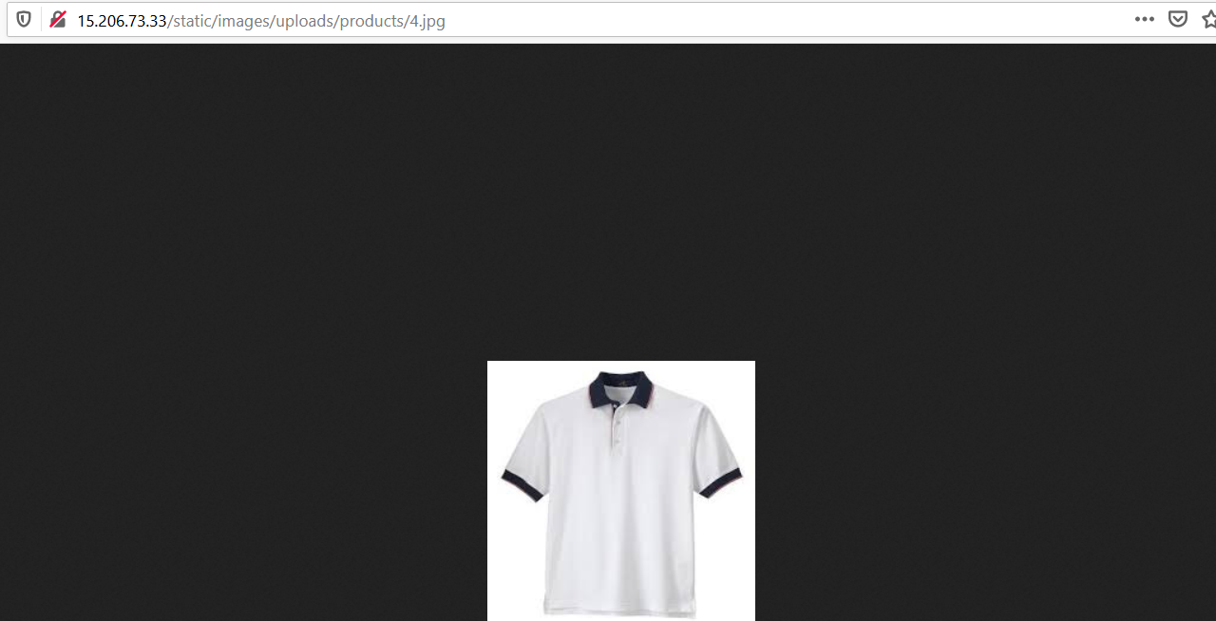
Observation
Navigate to http://15.206.73.33/products.php
Now click and drag any product image in a new tab,the following page will look like the one shown below with the image of the product you chose,

Slide 46
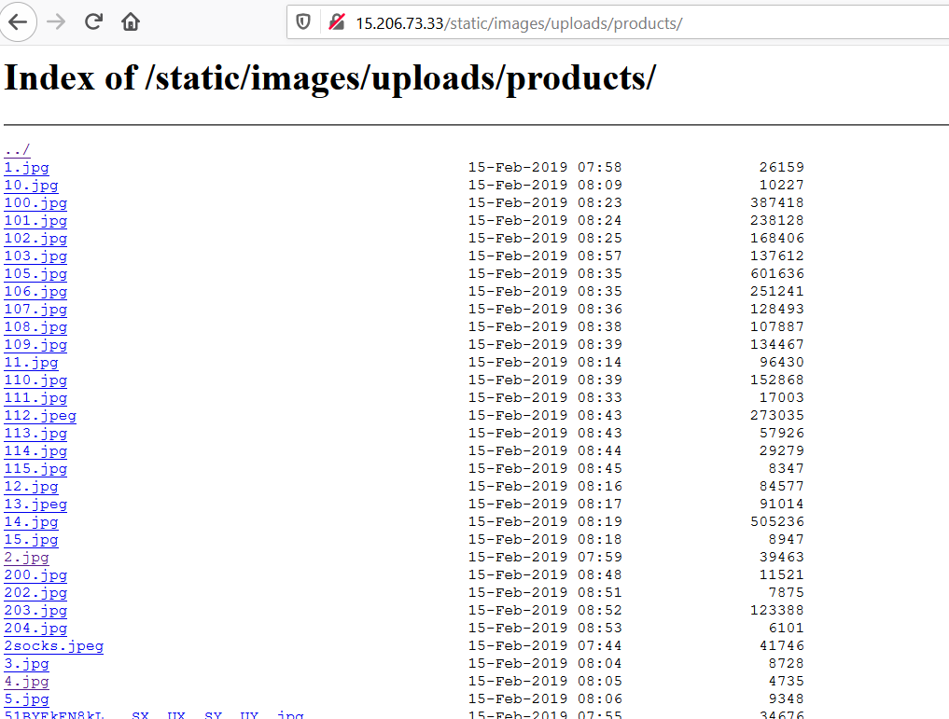
Observation
Now, we remove the image name i.e “4.jpeg” . In our case and hit enter , the following page with details will be shown

Slide 47
Business Impact – High
A malicious hacker can gain access to the shell application and various other HTML files which has been shown on the listings and also it has a weak-password flaw as well.
A hacker can get access to shell and upload his own malicious codes to make the site which is trusted by the user vulnerable and hackers room for phishing and tricking users ,which will result in defamation of the website.

Slide 48
Recommendation
Take the following precautions:
2 factor authentication for sensitive data should be added with strong passwords.
Find all PII stored and encrypt them with various techniques and also disable all the listings.
References:
https://owasp.org/www-project-top-ten/OWASP_Top_Ten_2017/Top_10-2017_A3-Sensitive_Data_Exposure

Slide 49
8. Self Redirection/HTML/Developer Flaw
Developer Flaw/HTML Flaw (Severe) | Below mentioned URL has a major development flaw, as it redirects to password reset link without authentication. Affected URL : http://15.206.73.33/reset_password/customer.php Affected Parameters : Password reset

Slide 50
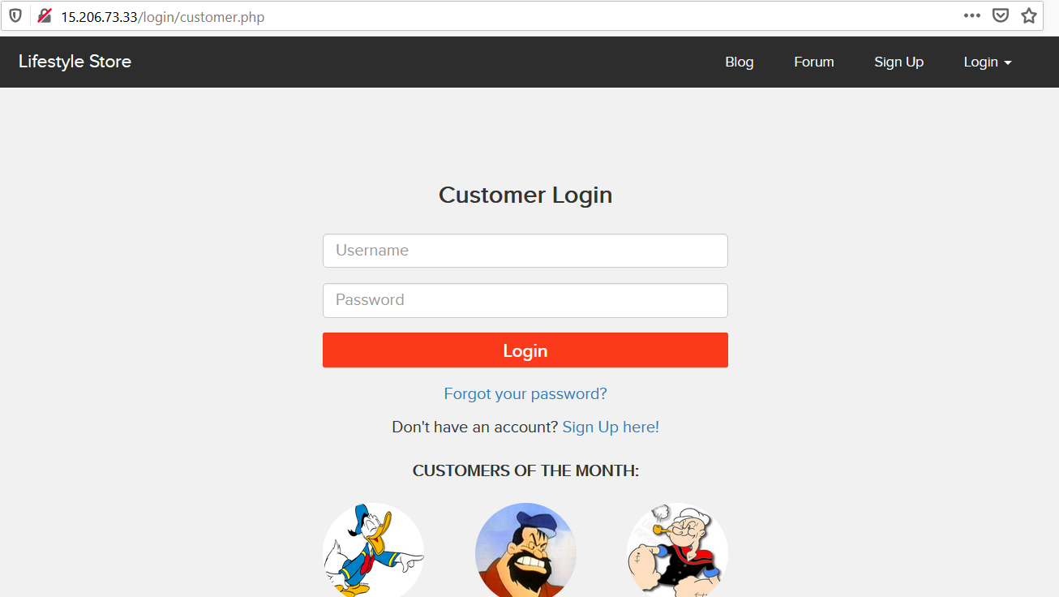
Observation
Navigate to http://15.206.73.33/login/customer.php
You’ll see ,names of top customers , as shown below, memorize any username.

Slide 51
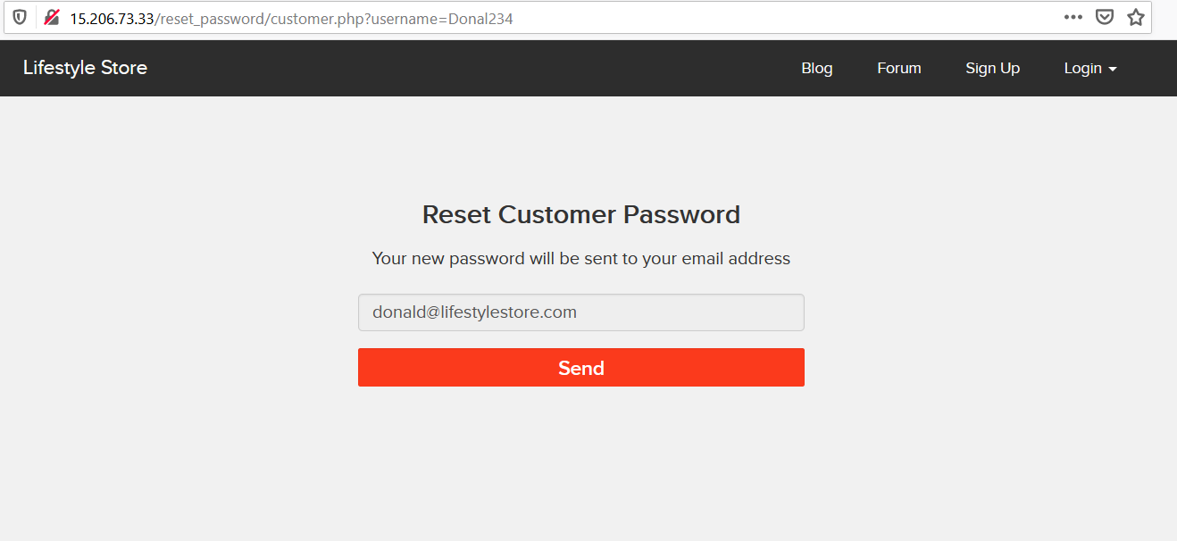
Observation
After memorizing any username, click “forgot your password” and then write the memorize username and click “Reset password” and then and we’ll see the page like this,click send.

Slide 52
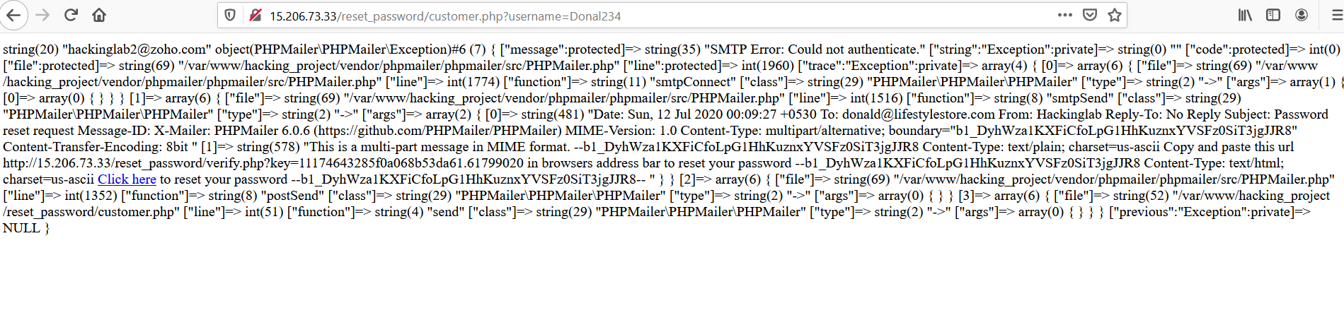
Observation
Click send and then you’ll see a page like this due to Development/Authentication error, click “click here” button and you’ll redirected to change the password of the customer.

Slide 53
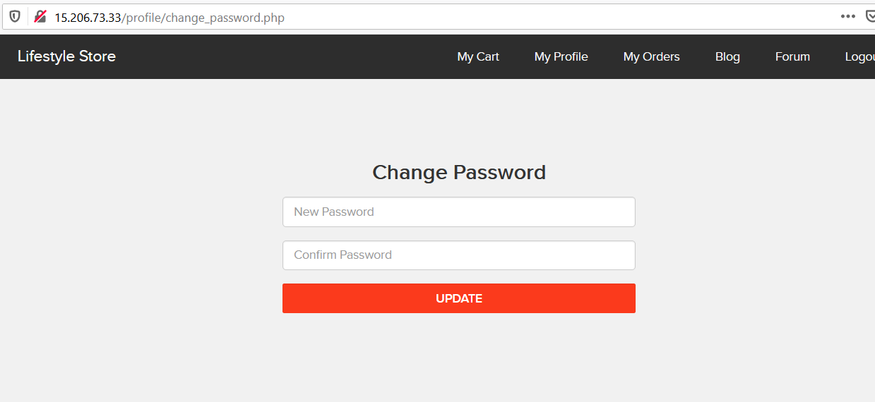
Observation
You’ll be redirected to change password of the customer id, and also you’ll be automatically logged in to that customer’s account even if you don’t change the password, You can change the password for completely takeover the customer id.(This page comes up looks like this)

Slide 54
Business Impact – High
Business impact is as high as a malicious hacker can get access to every user in the website and can login and perform task for his benefits .This makes the site vulnerable for security of customers . Results in defamation of the website as the user trust it.

Slide 55
Recommendation
Take the following precautions:
Better Authentication should be provided and re-direction site must be re-checked before in action.
Proper authentication access should be there.
References:
https://owasp.org/index.php/Testing_Multiple_Factors_Authentication_(OWASP-AT-009)

Slide 56
9. Multiple Vulnerabilities found in blog site(PII Leakage, Temporary XSS and more)
Multiple vulnerabilities in blog site (PII leakage, Temporary XSS and ){critical} | Below are the affected parameters and url of blog site. Affected URL : http://15.206.73.33/wondercms/ http://15.206.73.33/wondercms/files/b374kmini.php Affected Parameters : File upload(post) Affected URL : http://15.206.73.33/wondercms/home Affected Parameters : Files(GET) Affected URL : http://15.206.73.33/wondercms/files/shell.php Affected Parameters : Shell upload

Slide 57
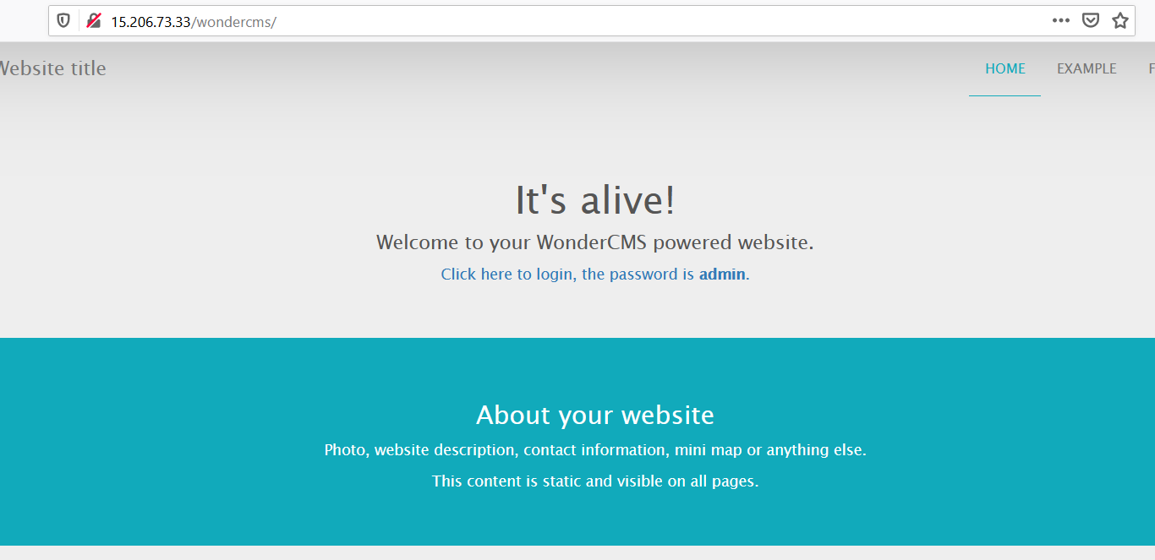
Observation
At the front page of the blog site we can directly find the login option, that says “click here to login, the password is ADMIN” by clicking on it, it will redirects to the login page where just by entering ‘ADMIN’ as password one can get access to the admin account of this site. This is a proper examples of server side misconfiguration.
The logged in page looks like below,

Slide 58
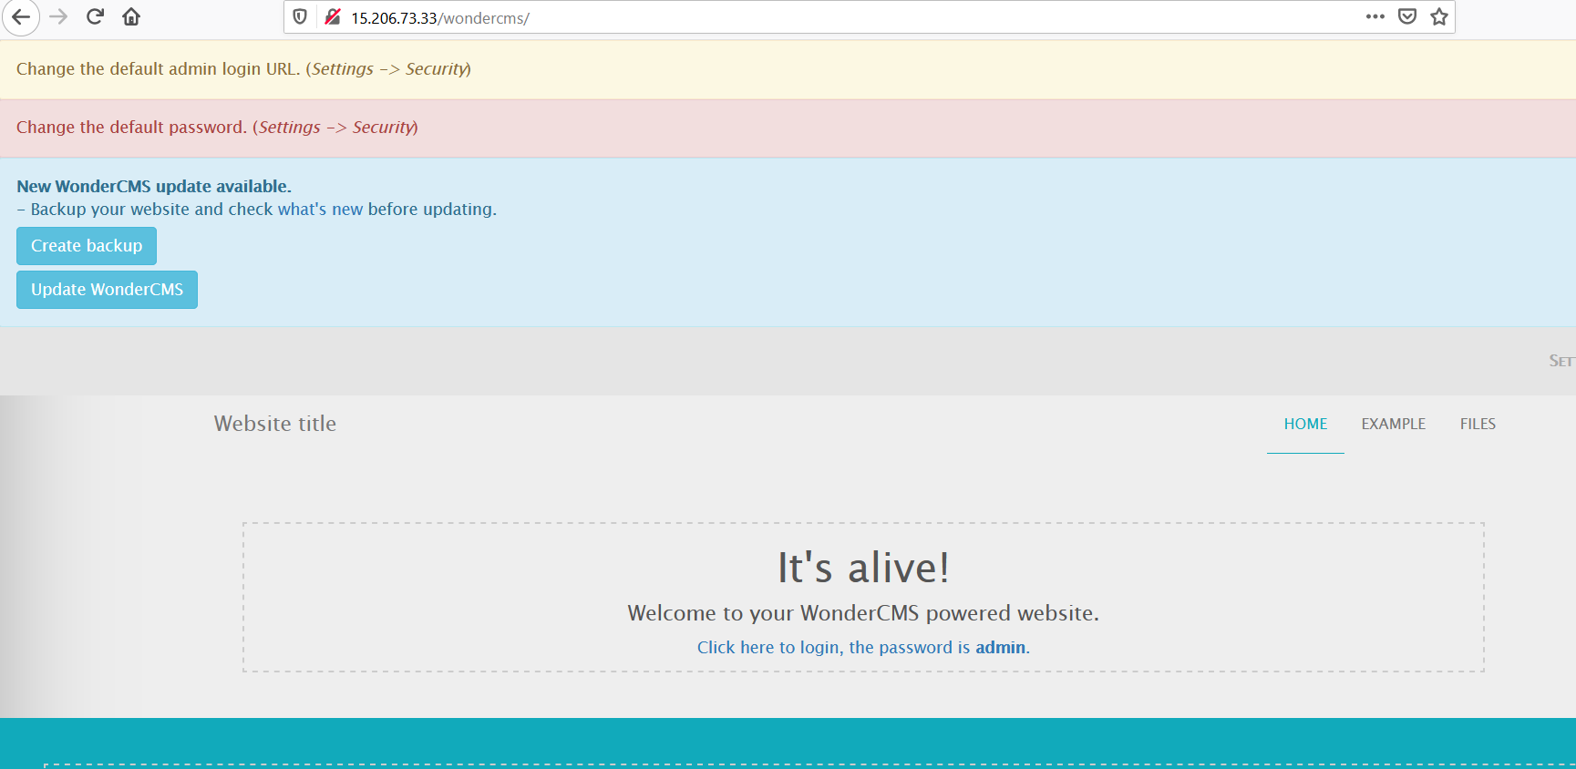
Observation
When we login as the admin, at the first page of the site we can see some text written as “It’s Alive! _ _ _” If we click on it, the html codes just starts running and one malicious hacker can easily make changes and can use the page as his/her phishing portal . This is a classic example of Temporary XSS.

Slide 59
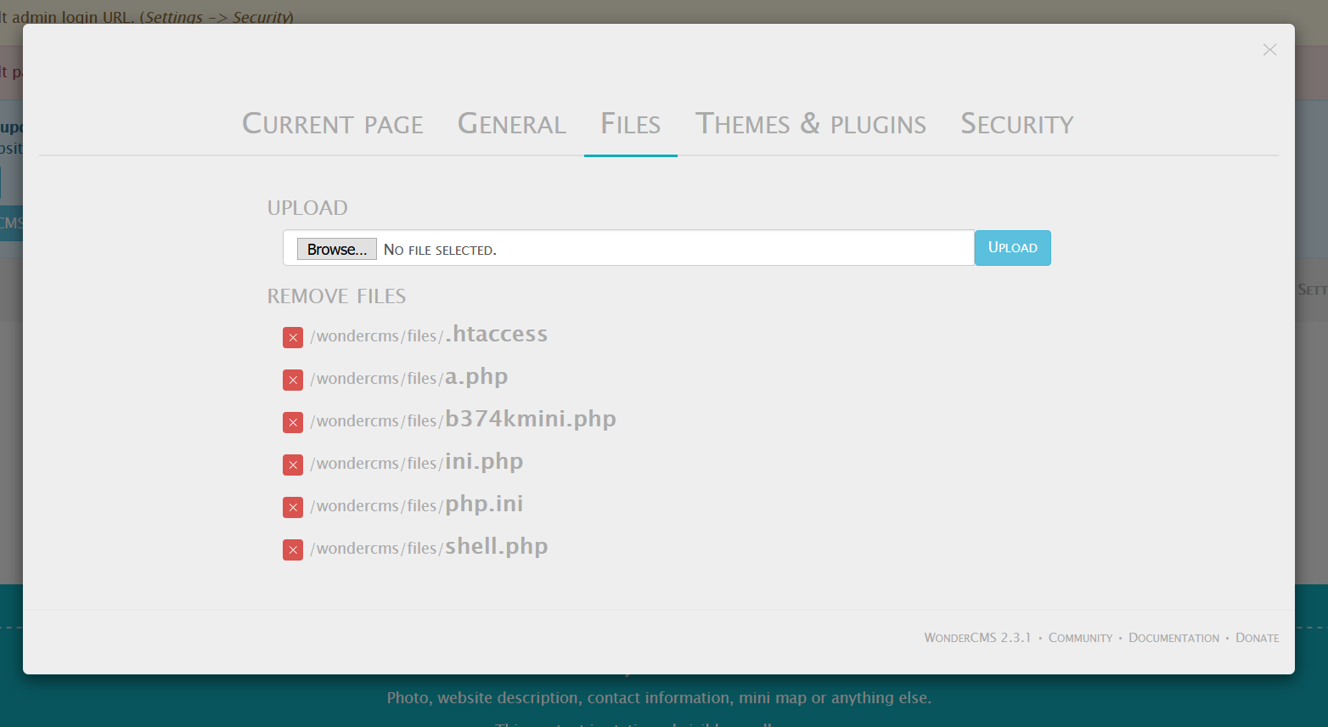
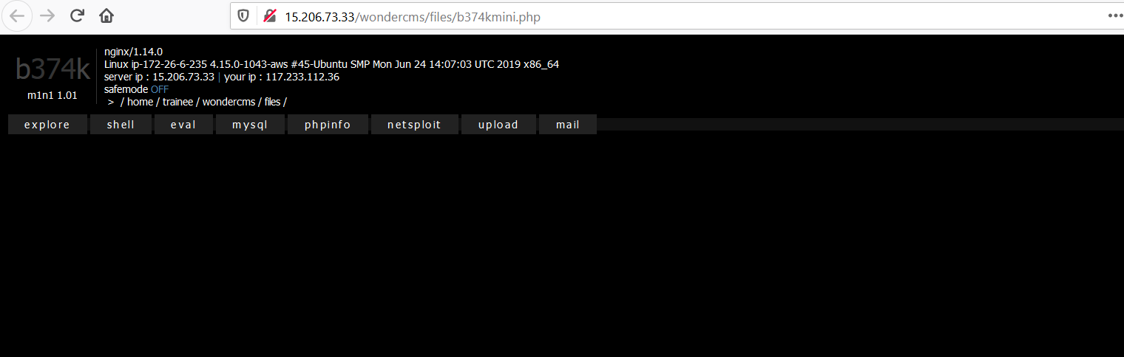
Observation
As we have are inside the admin account ,if we select the settings option and go to file menu we can see some files with extension ‘.php’ which can give information about the site and also very much capable of taking over the site . Here, if we select the http://15.206.73.33/wondercms/files/b374kmini.php
option it will redirect us to a page which will give us many crucial information like server ip address . Linux IP address, the server type , the database ,shell , the php info, uploads also one can mail someone with the admins account which can be termed as Phishing (Social Engineering).

Slide 60
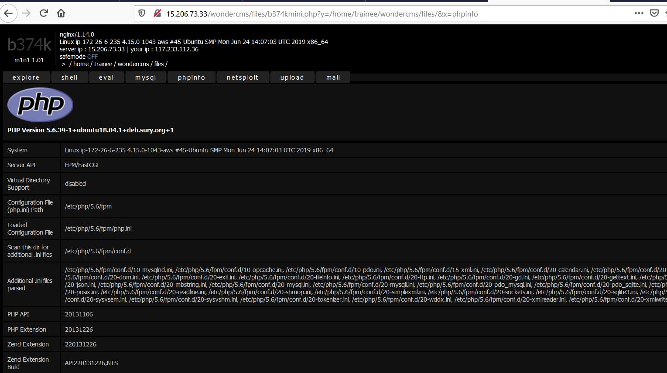
Observation
The page above , looks like from which the attacker can know all inside details like versions and more .

Slide 61
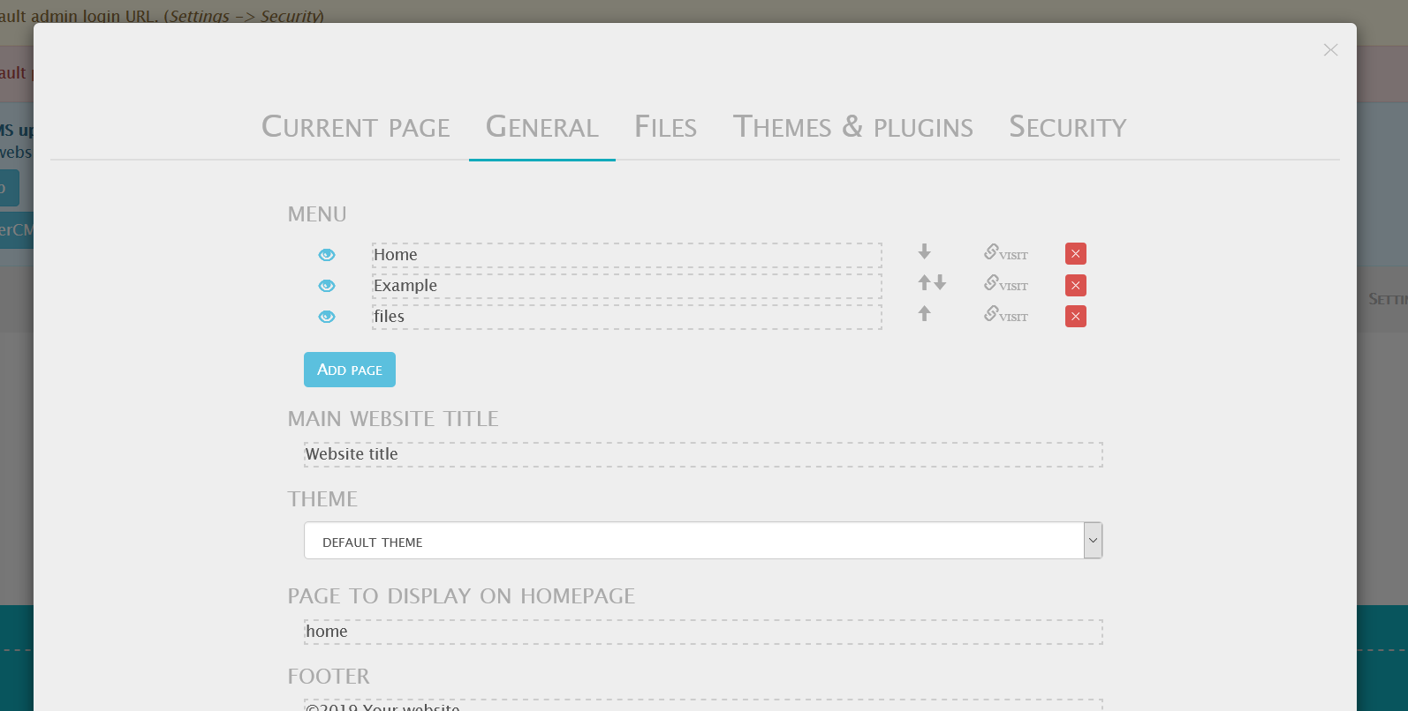
Observation
When we are in the admin account and we go to the settings -> General options, we can see that a malicious hacker can inject and execute malicious client side scripts through it which gets permanently in the database.

Slide 62
Observation
When we are in the admin account and we go to the settings -> Files option, we can find that files can be uploaded there with any file type extension one wants to upload . Now we click on choose file option and upload the minishell into the site, it will give access to takeover the whole website and will be a great breakage on the site.

Slide 63
Business Impact – High
As the blog site has multiple vulnerabilities and limitations as this has Temporary XSS, server side errors and development flaws the site is extremely vulnerable . As a malicious hacker can indulge in the site and can use all the vulnerable components.
To do phishing and other attacks on user and perform malicious activities this will result in defamation of the name of the company.
Money loss and customers will not trust the website again.

Slide 64
Recommendation
Try to implement the following:
The website should have proper two factor authentication.
Try to develop the backend more stronger and secure.
Remove all directory listings and add proper sanitization techniques at checks of the website.
References:
https://cwe.mitre.org/data/definitons/548.html
https://www.w3schools.com

Slide 65
THANK YOU
For any further clarifications/patch assistance, please contact:
Contact info:sagarnamdeo12@gmail.com
9407194881

